Slide 1

Authorization & Authentication
Submitted By :
Amarendhar Reddy Kokkonda – 200517437
Prasanth Parthiban – 200511271
Rahul Anand Sharada - 200520080

Slide 2

Project Summary
Project Summary includes the key parameters to create an API and how the API and the system is maintained with keeping the security at top
Data must be Authenticated and must have a check on Authorization so that no data is being accessed by a third party who is not having access for the same
Since data security is the major concern in data sharing and accessing the data over different systems , resources , company to company , business to customers, maintain the information standards are the most important factor

Slide 3
Project Summary
Created an ASP.net webapp with user data protected by authorization
In this we have created three roles:
Registered Users – Who can view all the approved data and can edit/delete their own data
Managers – Who can approve/reject contact data. Only approved contacts are visible to users
Administrators – Who can approve/ reject and edit/delete any data
Tasks
Create Asp.net core web application
Build a secure ASP.net core API
Add our own secure API and serve up a simple dataset of our own
Fetch the results on localhost
Tools Used
Visual Studio 2022
Post man
Microsoft SQL Server Management Studio

Slide 4



Team
Project Manager | Developer | Developer
Amarendhar Reddy Kokkonda 200517437 | Rahul Anand Sharada 200520080 | Prasanth Parthiban 200511271
BE in Computer Science | BE in Computer Science | Bachelor of Computer Application
Skills: Problem Solving, Logical Thinking, Communication | Skills: Critical Thinking, Problem Solving | Skills: Logical Thinking, Analytical Skills
Technical Skills: C, C++, Python, HTML, CSS, JavaScript, SQL | Technical Skills: Python, SQL | Technical Skills: Python, SQL

Slide 5

Part – 1 User Data Protected by Authorization

Slide 6
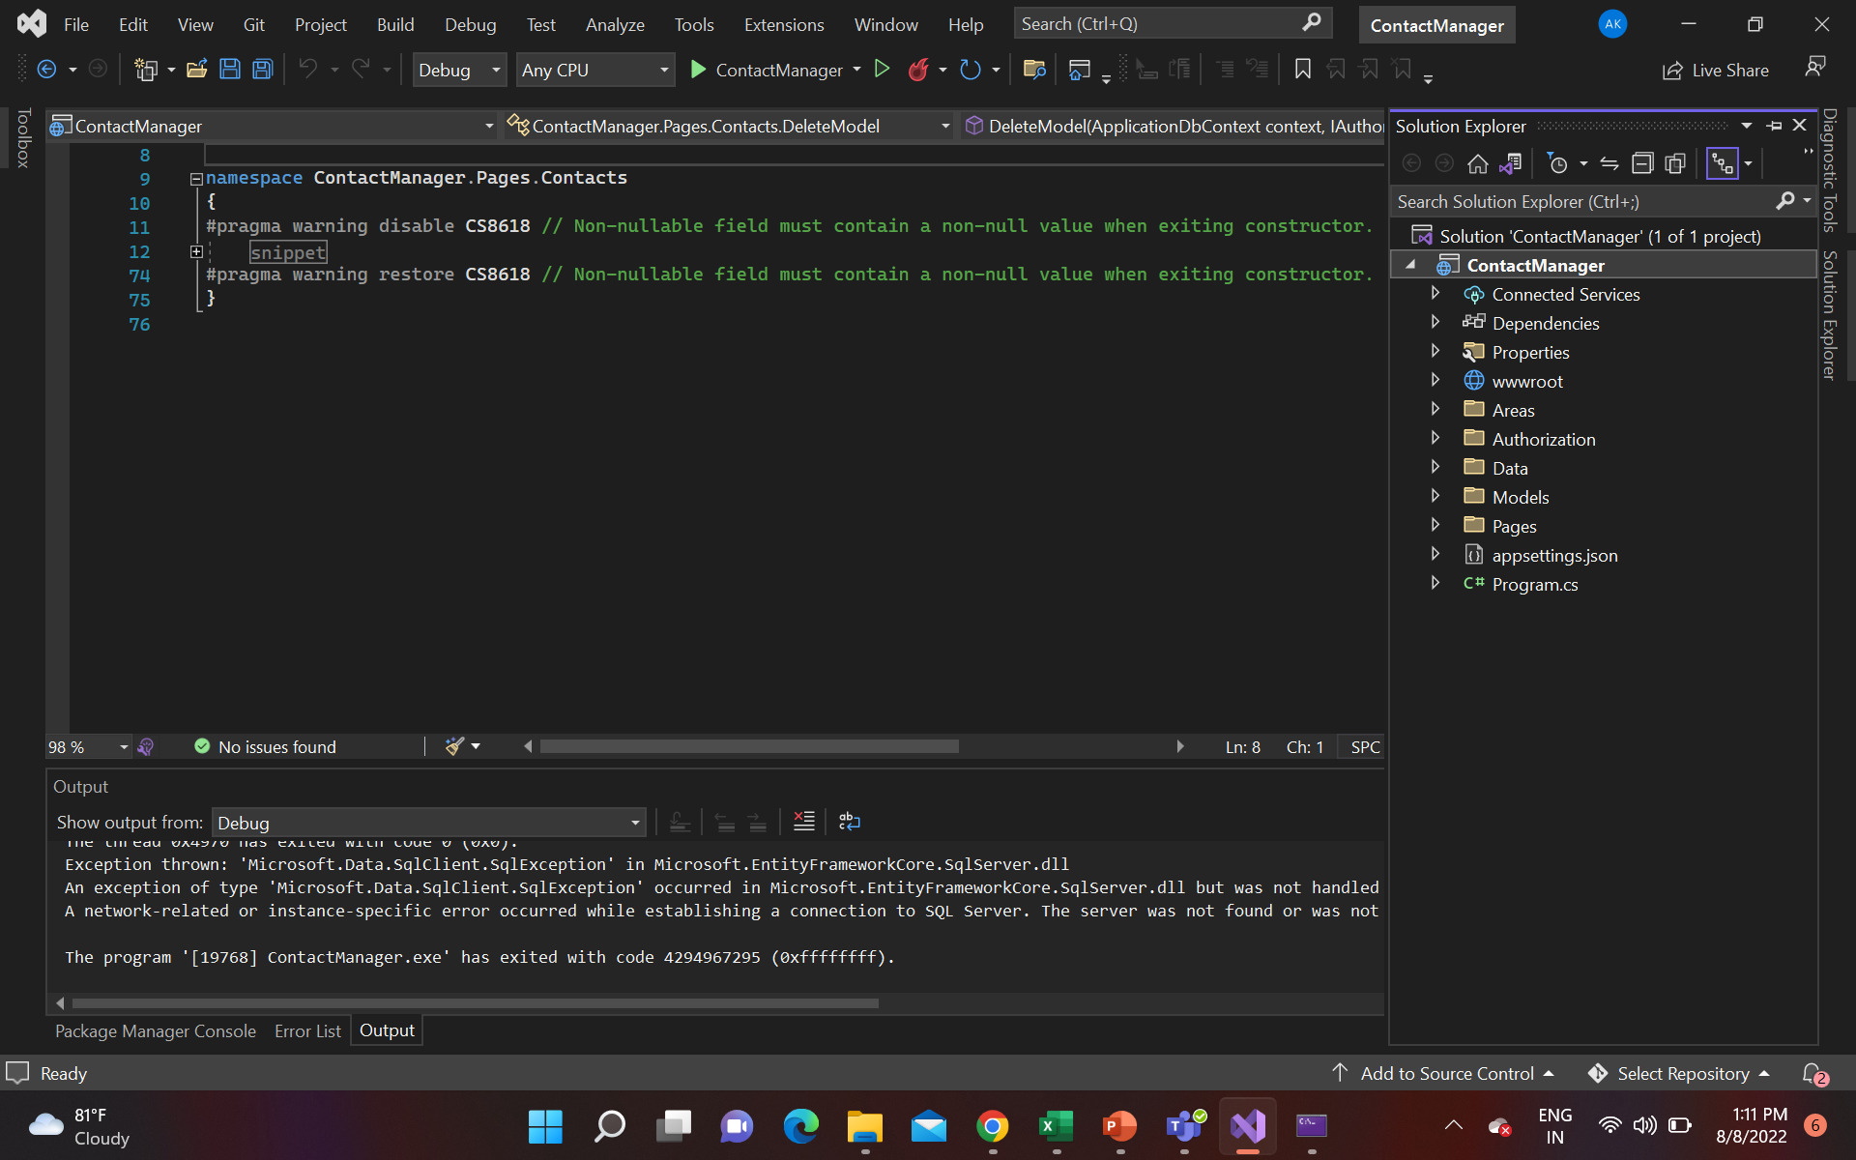
Step-1:
We have created a ASP.net core api project in visual studio with name ContactManager.
Then we have written some codes in C# which connects to an API and localhost database.
We used some packages and commands to deploy the project and run.

Slide 7
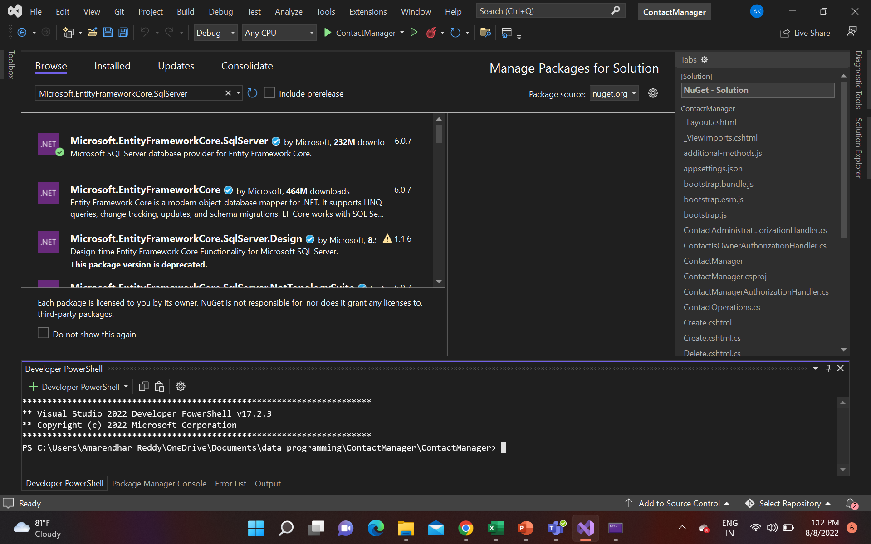
Step-2:
To run this project first and foremost we need to install four NuGet packages:
Microsoft.EntityFrameworkCore.SqlServer
Microsoft.EntityFrameworkCore.Tools
Microsoft.AspNetCore.Identity.EntityFrameworkCore
Microsoft.AspNetCore.Authentication.JwtBearer

Slide 8
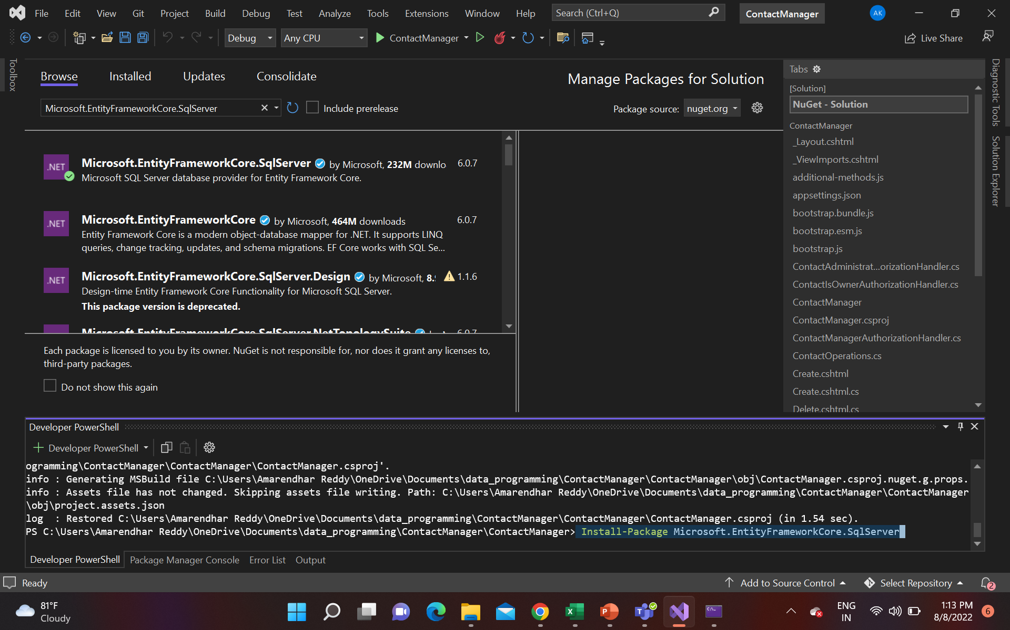
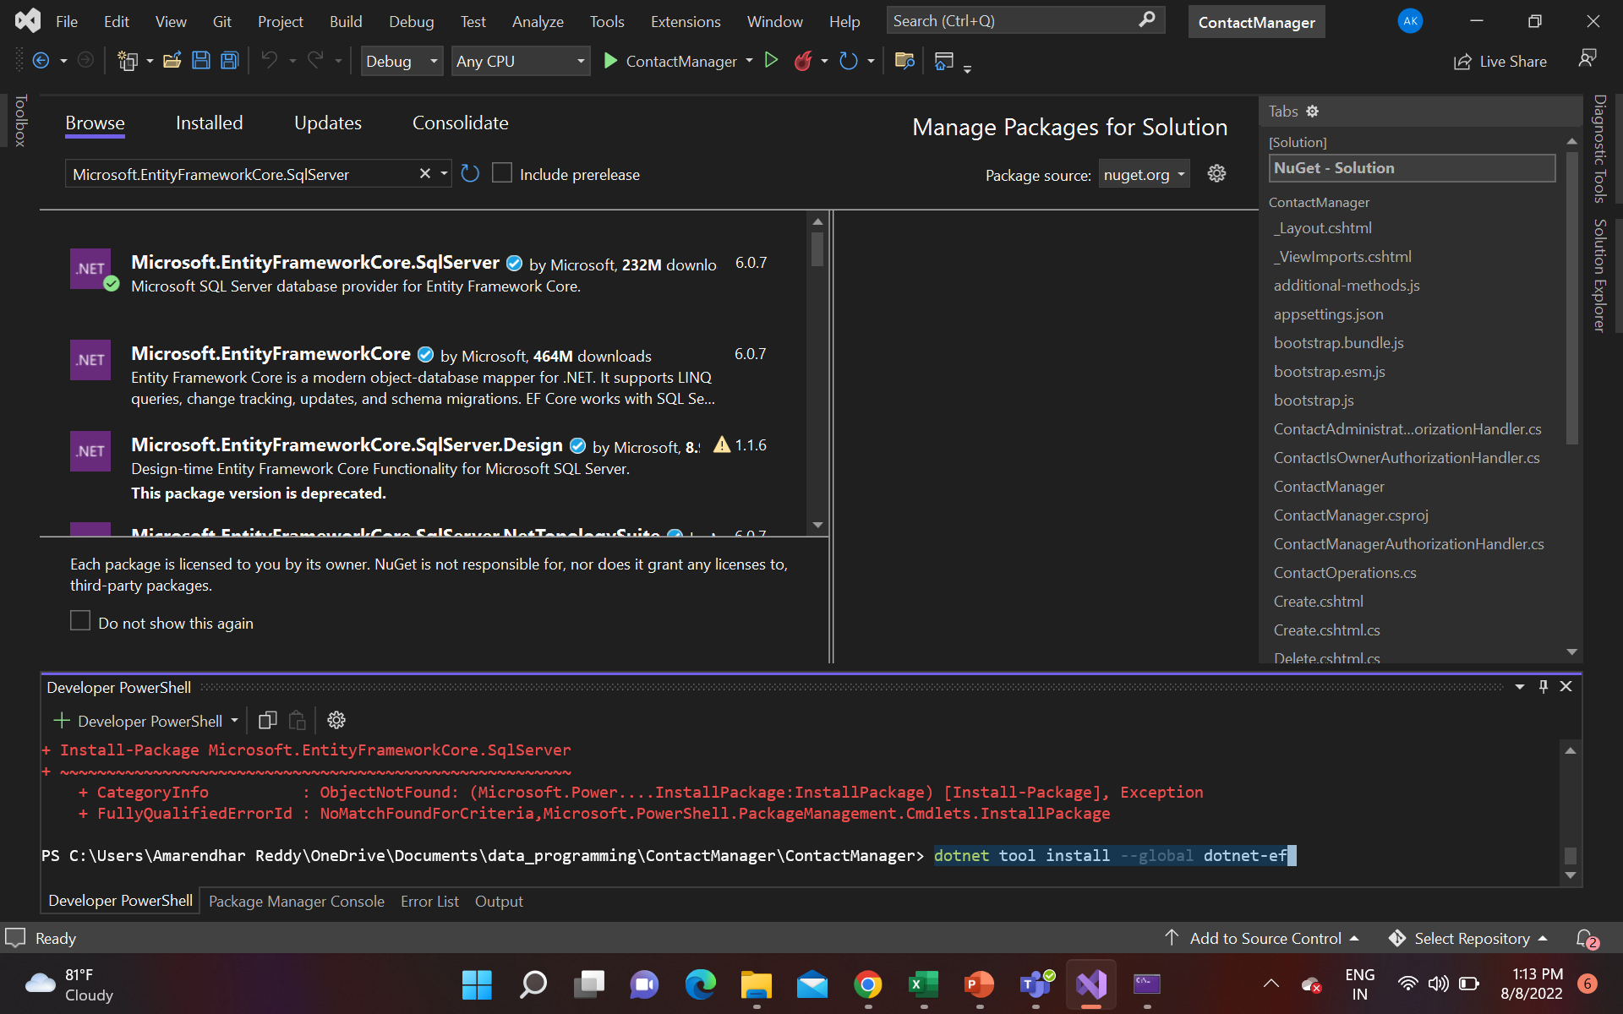
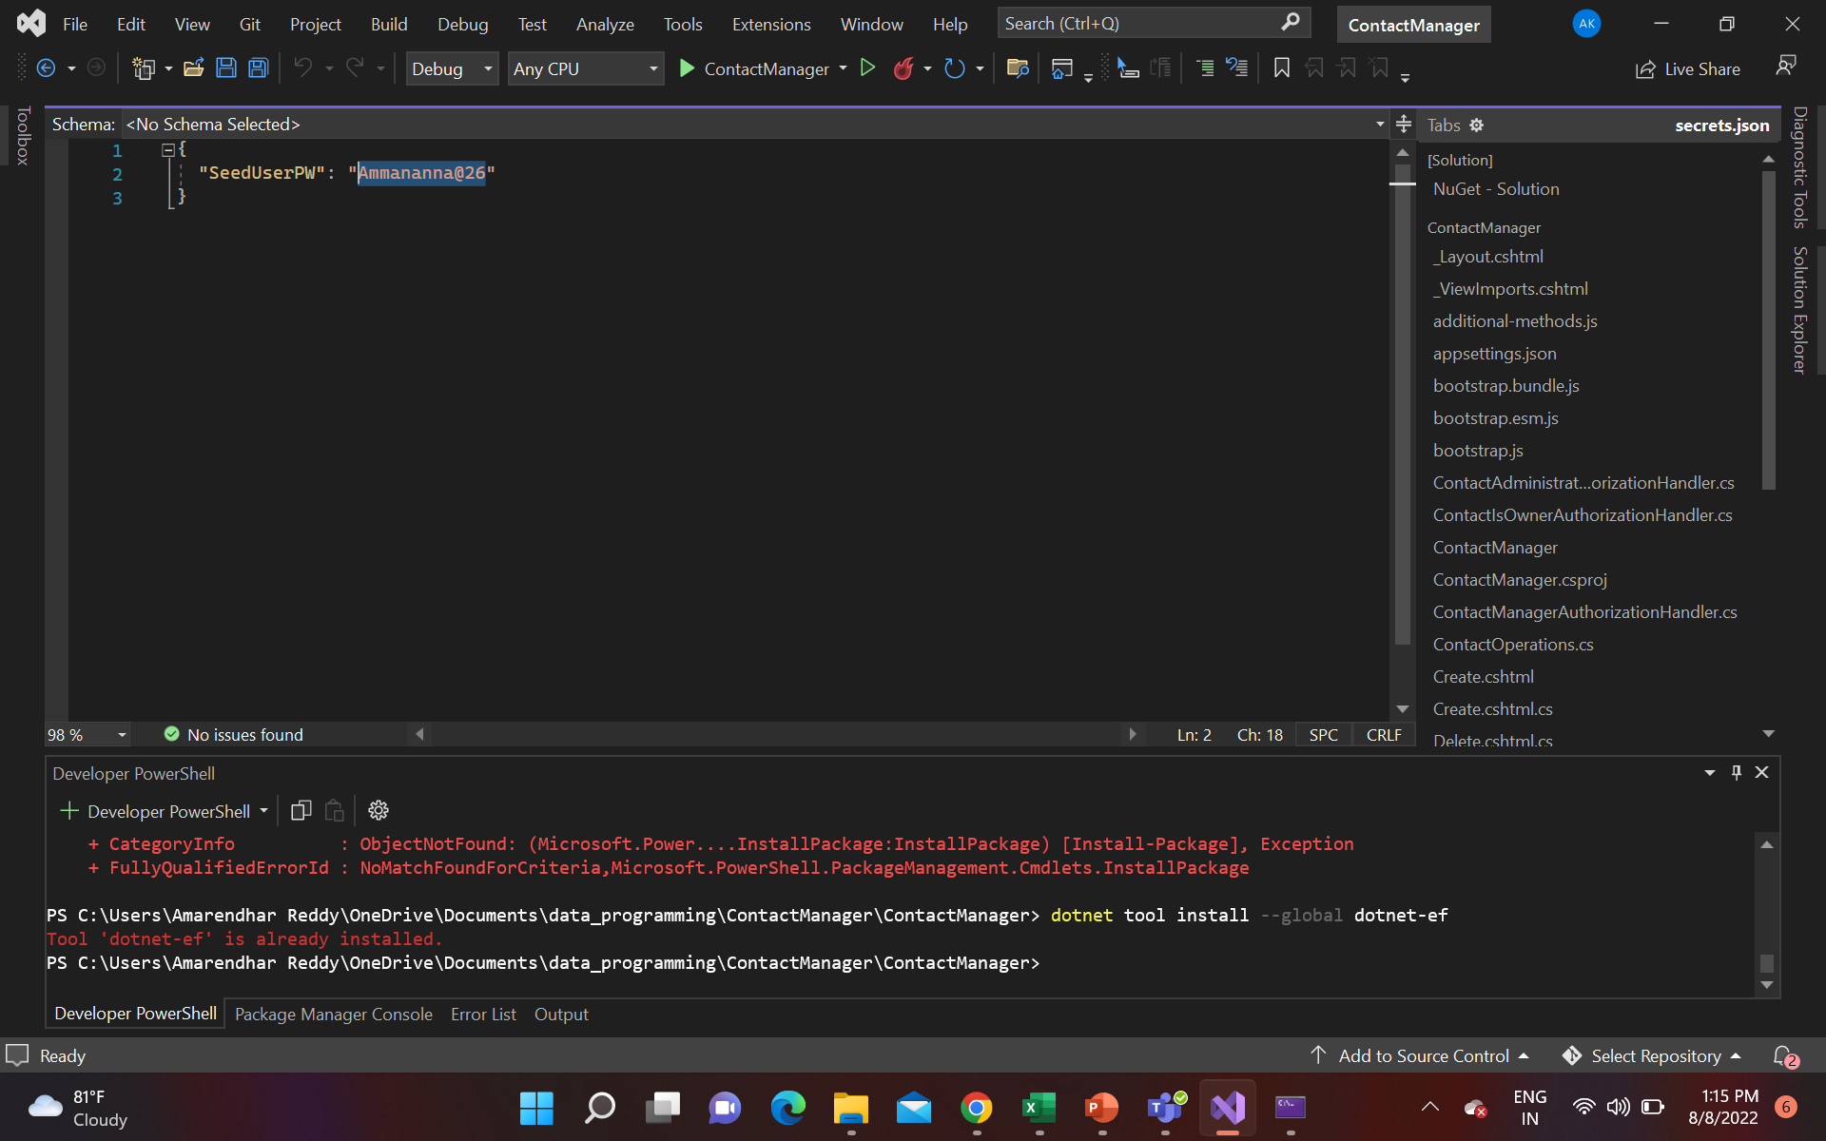
Step-3:
Connect with the database we need to install and add few packages that can be done by using following commands:
dotnet add package Microsoft.EntityFrameworkCore.SqlServer
Install-Package Microsoft.EntityFrameworkCore.SqlServer
dotnet tool install --global dotnet-ef

Slide 9
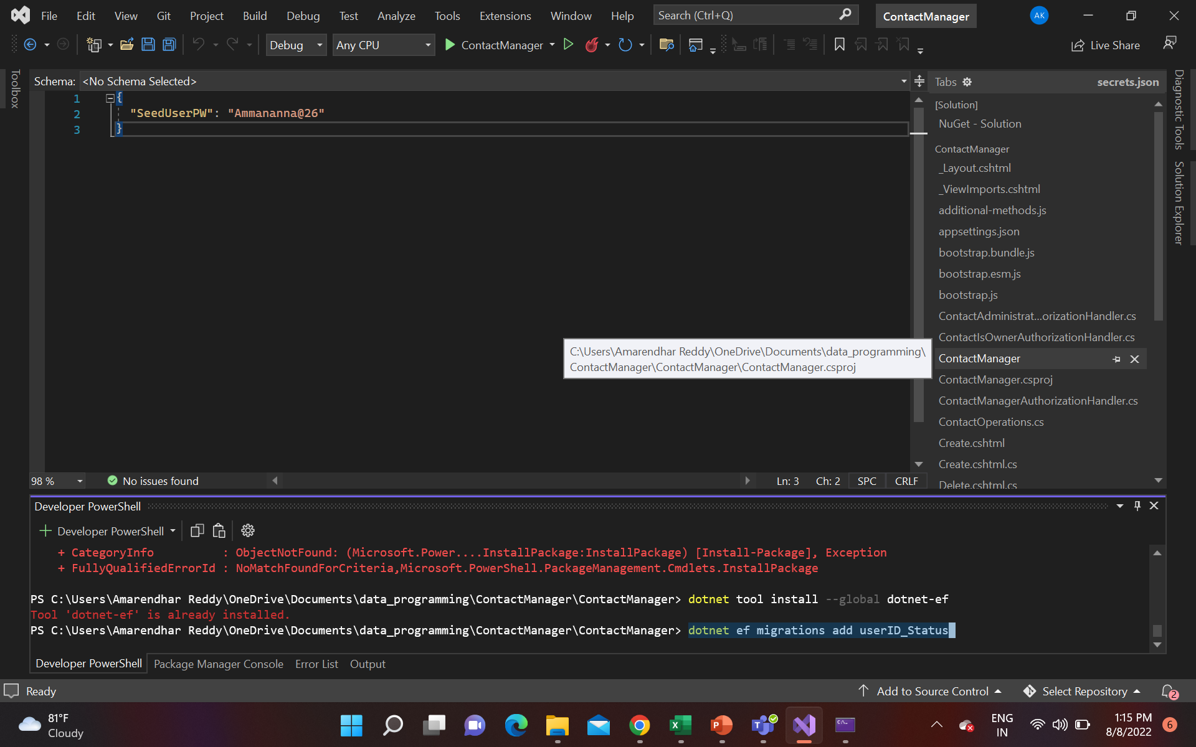
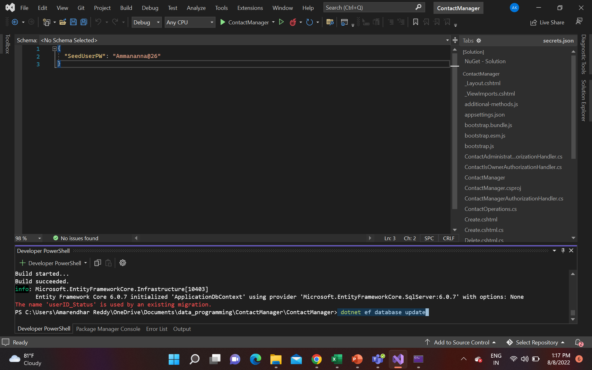
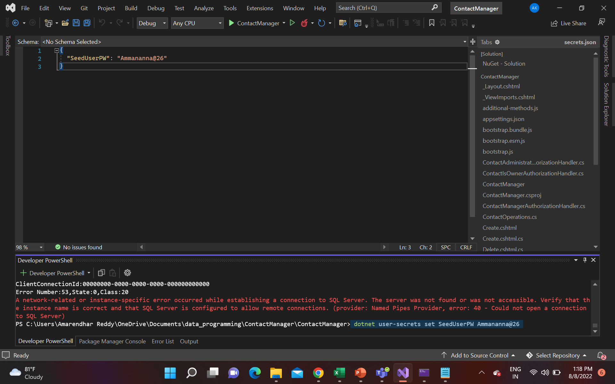
Step-4:
To interact with database, we used few commands which allows us to create, generate, edit migrations:
dotnet ef migrations add userID_Status
dotnet ef database update
dotnet user-secrets set SeedUserPW <PW>

Slide 10
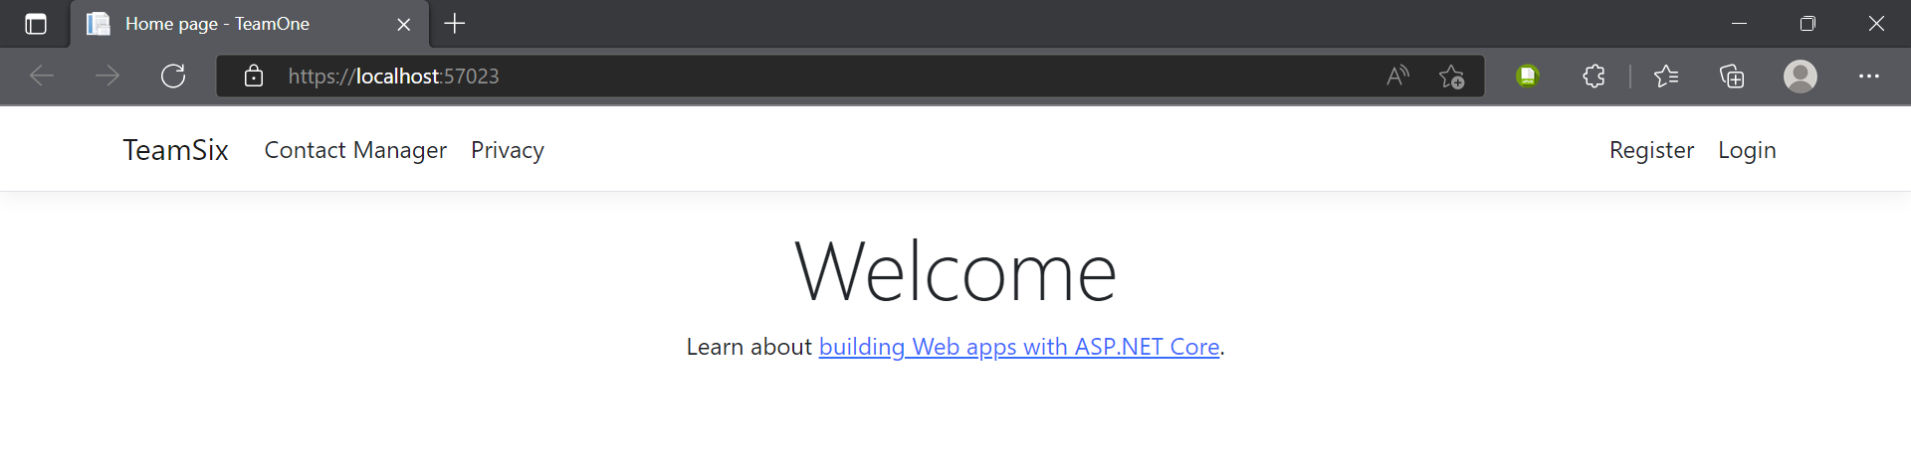
Results:
This is how our home page looks like.
By clicking on Register at top-right we can register into the system.
By clicking on Login, we can login into the system.
By clicking on Contact Manager, it takes us into the Contact Manager Page where we can see all the data.

Slide 11
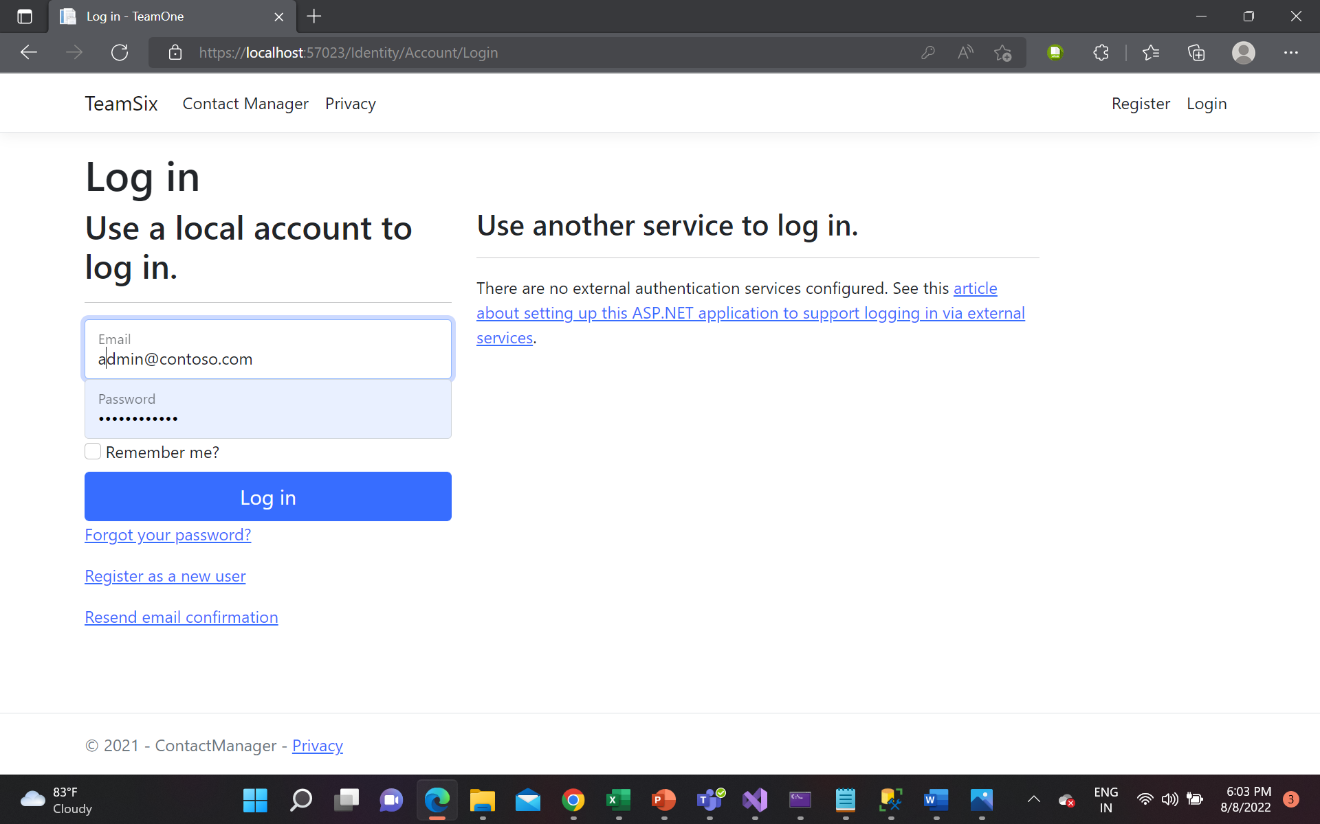
Results:
This is how our Login page looks like.
We need enter our login credentials to get into our system.
By clicking on Login, we can login into the system.
If we forgot password, we could use Forgot password, but sending mails wont work has we have not included any function for that.
Same Resend email confirmation also wont works because no function written for it.
We can use Register as a new user if we are new into the system.

Slide 12
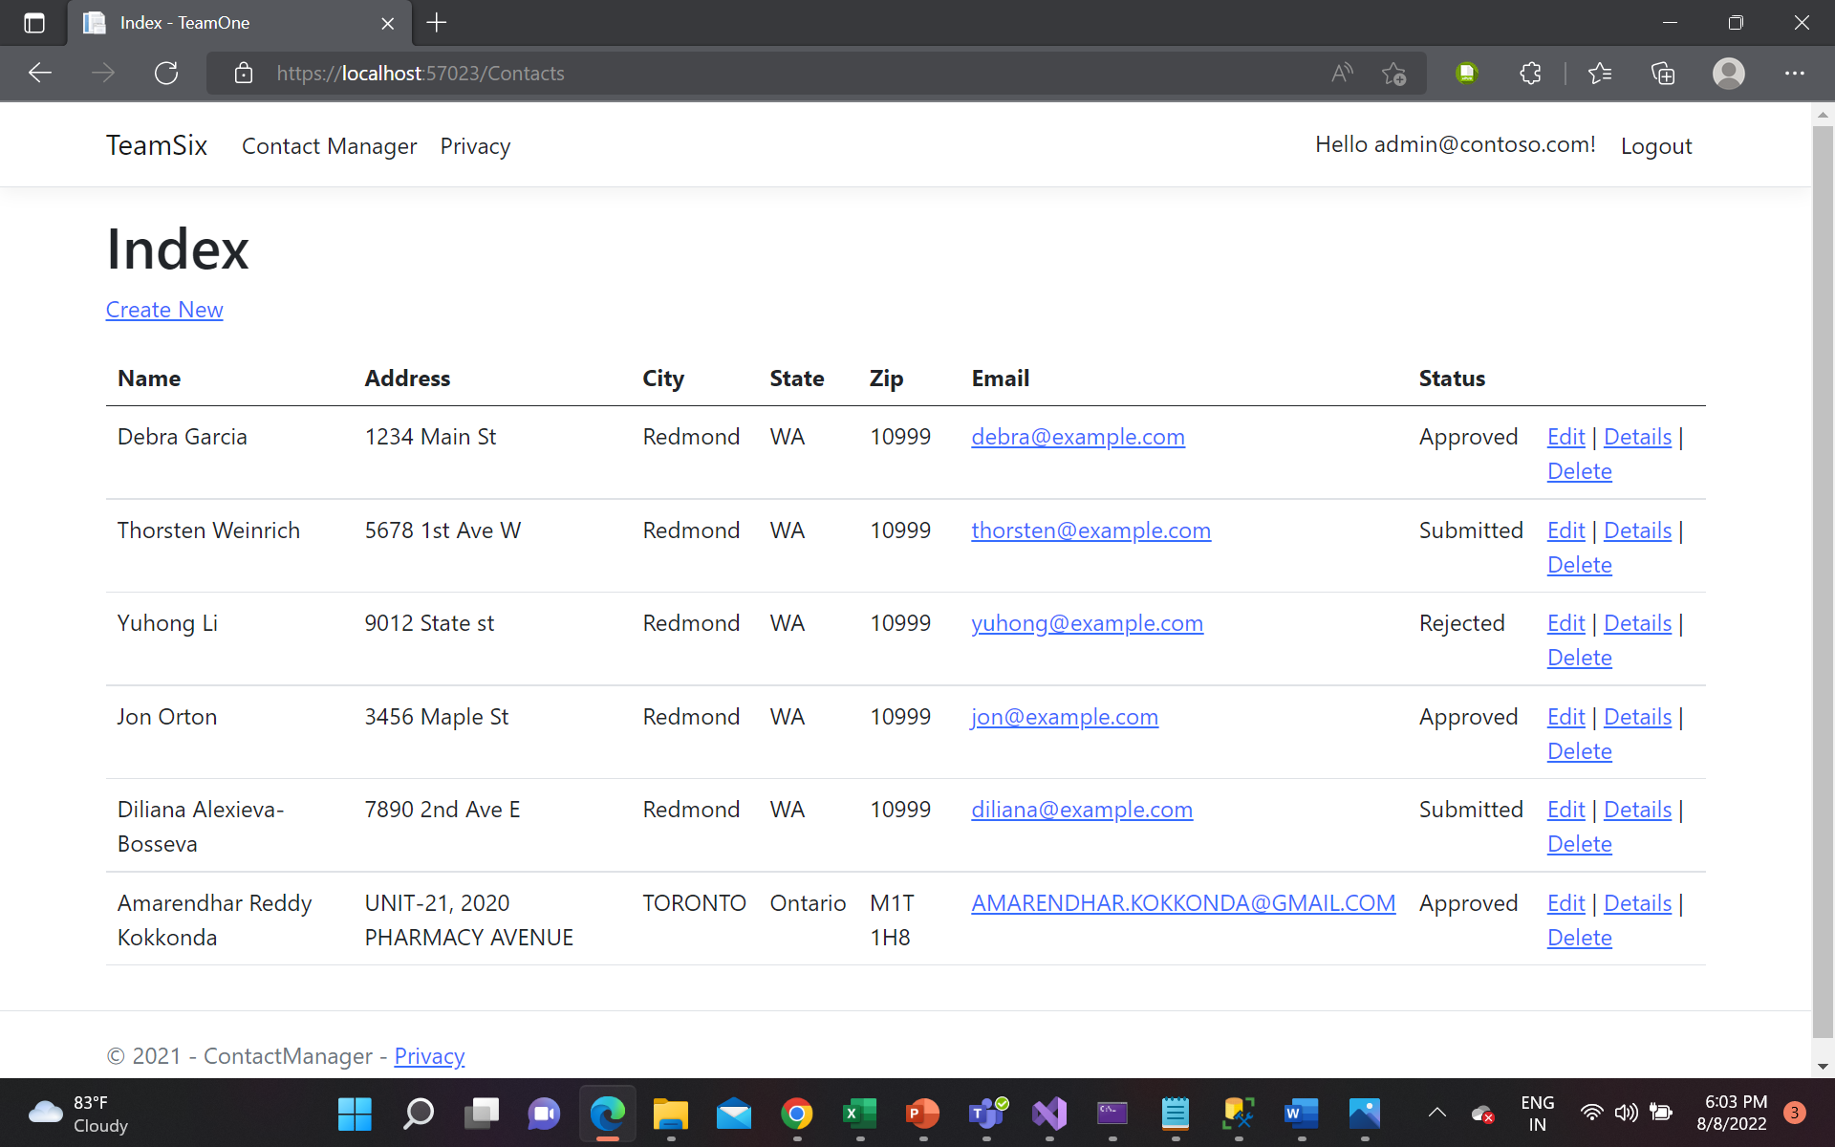
Results:
This is the Index page of Admin where he can view all the users and can approve/reject and edit/delete user from the system.

Slide 13
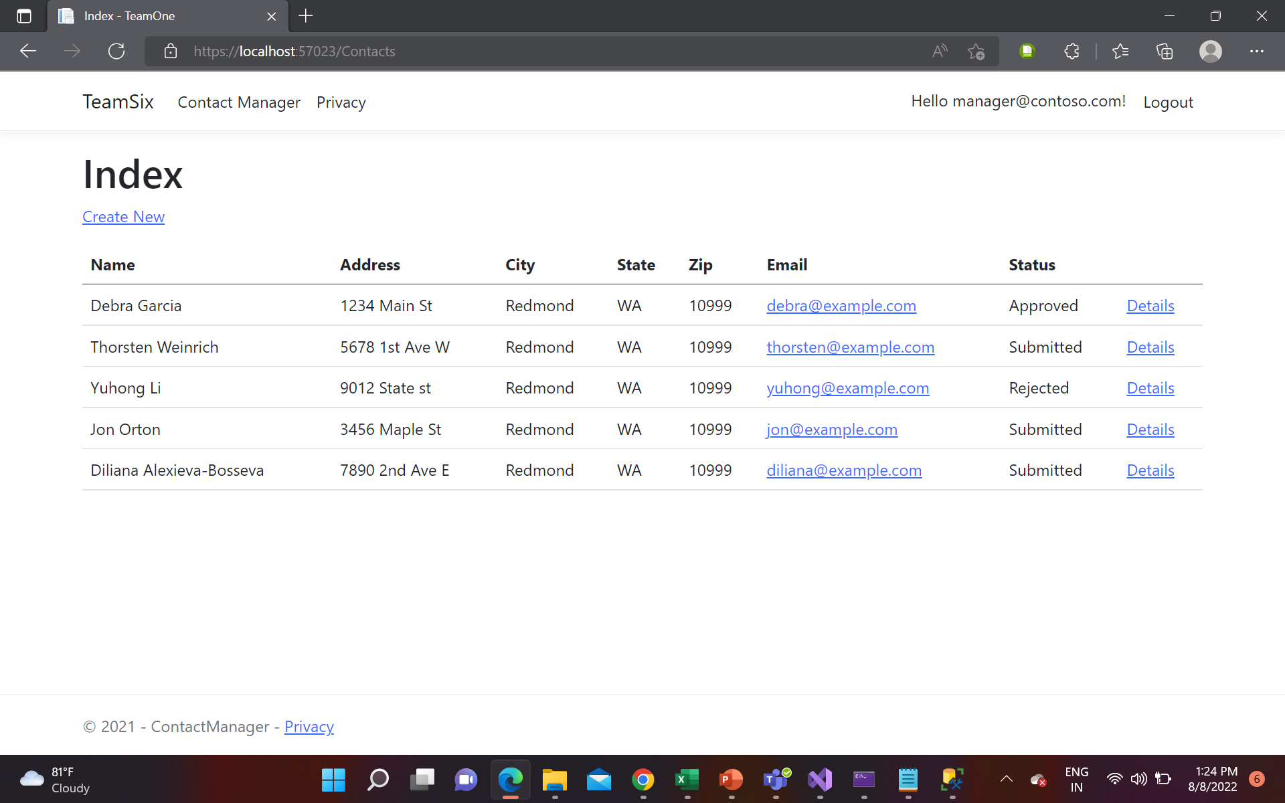
Results:
This is the Index page of Contact Manager where he can view approved users, and manager can approve/reject user from the system.

Slide 14
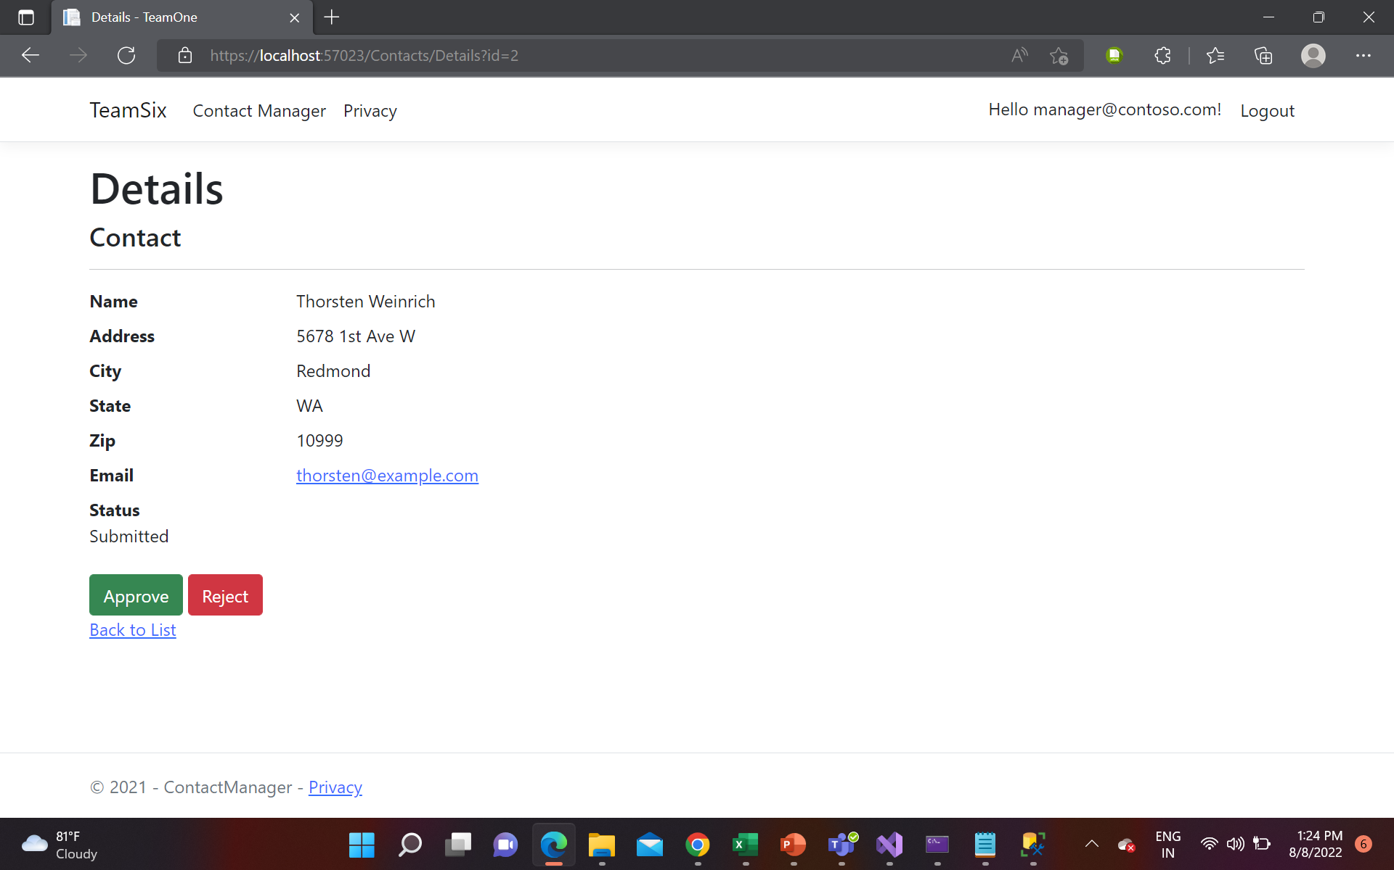
Results:
Details page which can be accessed by manager, where he can see all the details of a particular user and he can approve or reject from here.

Slide 15
Part – 2 Security Technologies Recommendations

Slide 16
TASK : A company is asking for you to act as a consultant on a project. They have some questions that they hope you can answer:
How can we transfer personal data securely within their network?
The Secure Socket Shell (SSH) protocols can be used if data needs to be transferred securely within a network . SSH suite of protocols is an ideal method for secure data transfer as it comes with complex password as well as a public key authentication .
In addition to this SSH also provides encryption of data and thus it can be used to transfer personal data securely within a network .
Other than this Managed File Transfer (MFT) , FTP ,HTTP can be considered to transfer the data

Slide 17
TASK : A company is asking for you to act as a consultant on a project. They have some questions that they hope you can answer:
2. What security protocol is best for transferring personal files?
SFTP protocol is the prime amongst all the available protocols that can be used to transfer personal data, it uses a more safe dual authentication process that is consists of complex password and SSH keys .
SFTP is compatible with almost all the OS available such as Linux, Windows , MacOS.
SFTP support strong NIST algorithms to ensure best security .

Slide 18
TASK : A company is asking for you to act as a consultant on a project. They have some questions that they hope you can answer:
3. Can we encode and encrypt images?
Yes , images can be encoded and encrypted by using various encryption algorithm/methods.
We can use third party encryption tools which shuffle random pixels of images as per algorithmic logic and then decode the image using same logic at the receivers end. Also can create our own tool using the techniques Encryption and Decryption algorithm/methods.

Slide 19
TASK : A company is asking for you to act as a consultant on a project. They have some questions that they hope you can answer:
4.Our database cannot be moved from the site, and we need to be able to access it externally using a secure API. Can you explain the architecture of a secure API?
If accessing the database using external API, We need to make sure that our data is being access correctly and is secured to be access by all means
Architecture followed for a secure API is build on the basis so that our backend and frontend work can be migrated using a cloud service securely without any issues.
REST API can be considered.

Slide 20
TASK : A company is asking for you to act as a consultant on a project. They have some questions that they hope you can answer:
5.Can you recommend a secure framework for coding an API?
A secure framework must consider Authorization and must be secure so that the PUT and POST methods used to input the data in system or database must not hamper the integrity of the data.
Authentication and Authorization must be implemented on a framework to be used in coding of App

Slide 21
TASK : A company is asking for you to act as a consultant on a project. They have some questions that they hope you can answer:
6. What data interchange format should we use while transferring data between locations?
Java Script Object Notation(JSON) is a data interchange format that can be used in order to transfer data between locations .
Although It is an extension of Java script, It does not have any dependency on the programming language. It is easy to parse and write .
It has been built to replace xml as xml files are comparatively difficult to write and parse.

Slide 22
TASK : A company is asking for you to act as a consultant on a project. They have some questions that they hope you can answer:
7. How should we store our data in our many locations?
To replicate the data on different servers across multiple locations we can use RDBMS to access that data whenever we need it and store our data in many locations.
For example- Mirroring and striping characteristics of Oracle database can be used to store data at multiple locations . This gives additional security of data as well as easy access .

Slide 23
TASK : A company is asking for you to act as a consultant on a project. They have some questions that they hope you can answer:
8. What are the ethical concerns related to the transmission of personal data?
Personal Data must not be shared without sources who don’t have the access to it.
Privacy must be a key parameter and privacy breach should not be Acceptable.
Data should not get leaked out due to security breach or hacking.
Data must not be shared to any other parties without having a mutual consent on it.

Slide 24
REFERENCES LINK
Credits : Ms Nital Shah for sharing the knowledge and to set up an environment for sharing the data with security
Links : Class learning sections , material provided in class

Slide 25
THANK YOU

